Slide 1
Ch-11. Interfaces, Types, and Roles
An interface is a collection of operations that are used to specify a service of a class or a component.
A type is a stereotype of a class used to specify a domain of objects, together with the operations (but not the methods) applicable to the object.
A role is the behavior of an entity participating in a particular context.

Slide 2
Graphically, an interface is rendered as a circle; in its expanded form, an interface may be rendered as a stereotyped class in order to expose its operations and other properties.
Interfaces may also be used to specify a contract for a use case or subsystem.

Slide 3
Names
An interface name must be unique within its enclosing package.
Every interface must have a name that distinguishes it from other interfaces.
A name is a textual string. That name alone is known as a simple name; a path name is the interface name prefixed by the name of the package in which that interface lives.

Slide 4
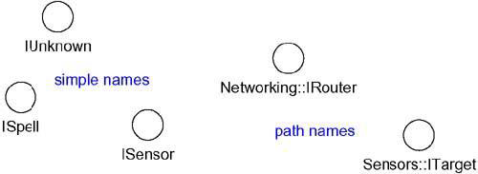
Simple and Path Names

Slide 5
To distinguish an interface from a class, consider prepending an I to every interface name, such as IUnknown and ISpelling.
To distinguish a type from an interface or a class, consider prepending a T to every type, such as TNatural and TCharacter.

Slide 6
Operations
An interface is a named collection of operations used to specify a service of a class or of a component.
Unlike classes or types, interfaces do not specify any structure (so they may not include any attributes), nor do they specify any implementation (so they may not include any methods, which provide the implementation of an operation).

Slide 7
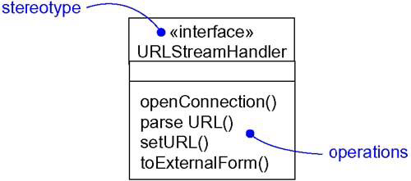
Like a class, an interface may have any number of operations.
Operations

Slide 8
Relationships
Like a class, an interface may participate in generalization, association, and dependency, realization relationships.
Realization is a semantic relationship between two classifiers in which one classifier specifies a contract that another classifier guarantees to carry out.
An interface specifies a contract for a class or a component without dictating its implementation.
A class or component may realize many interfaces.

Slide 9
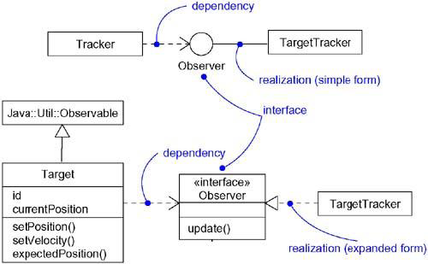
Realizations

Slide 10
First, you can use the simple form in which the interface and its realization relationship are rendered as a lollipop sticking off to one side of a class or component.
Second, you can use the expanded form in which you render an interface as a stereotyped class, which allows you to visualize its operations and other properties, and then draw a realization relationship from the classifier or component to the interface.

Slide 11
Roles
A class may realize many interfaces. An instance of that class must therefore support all those interfaces, because an interface defines a contract, and any abstraction that conforms to that interface must, by definition, faithfully carry out that contract.
In a given context, an instance may present only one or more of its interfaces.
In that case, each interface represents a role that the object plays.

Slide 12
A role names a behavior of an entity participating in a particular context.
Stated another way, a role is the face that an abstraction presents to the world.
For example, consider an instance of the class Person. Depending on the context, that Person instance may play the role of Mother, Employee, Customer, Manager, Pilot, Singer, and so on.

Slide 13
When an object plays a particular role, it presents a face to the world, and clients that interact with it expect a certain behavior depending on the role that it plays at the time.
For example, an instance of Person in the role of Manager would present a different set of properties than if the instance were playing the role of Mother.

Slide 14
Types
If you want to formally model the semantics of an abstraction and its conformance to a specific interface, you'll want to use the defined stereotype type.
Type is a stereotype of class, and you use it to specify a domain of objects, together with the operations (but not the methods) applicable to the objects of that type.
The concept of type is closely related to that of interface, except that a type's definition may include attributes while an interface may not.

